Slide 1

Name:
Arash Harirpoosh
Student Number:
9731505
Presentation Title:
PWM - ADC

Slide 2
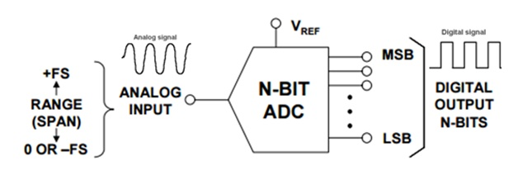
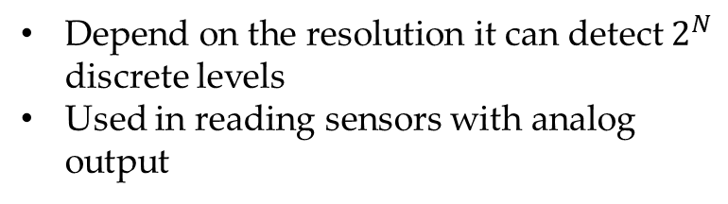
What is ADC?
Analog to Digital Convertor
directly converts the continuous form of signal to discrete form so that they can easily be read by the digital devices
ADC in microcontrollers
Depend on the resolution it can detect $2^{N}$ discrete levels
Used in reading sensors with analog output

Slide 3
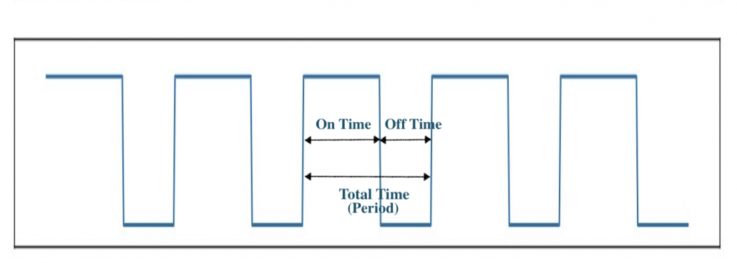
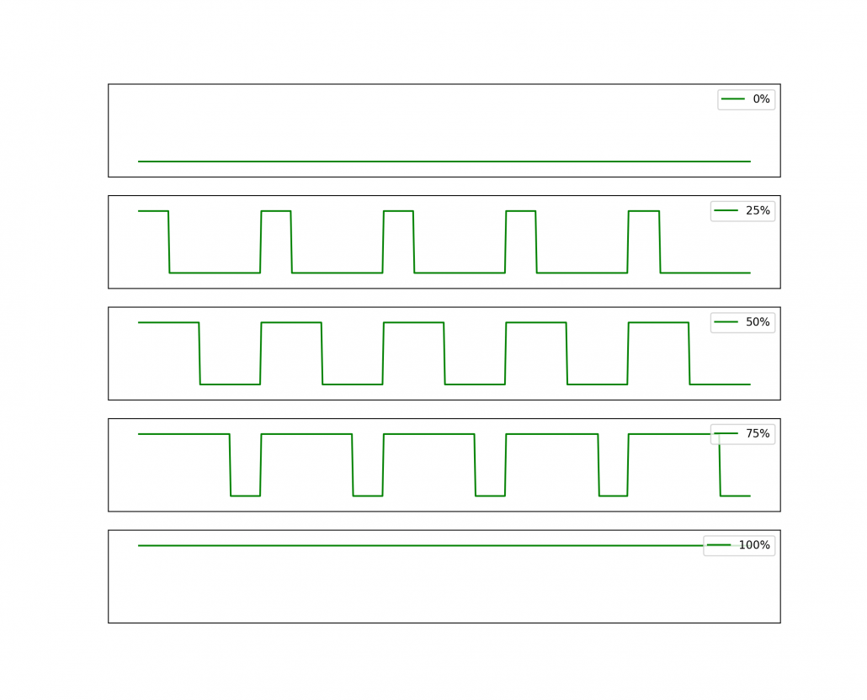
What is PWM?
Pulse Width Modulation(PWM) is a digital technology that uses the amount of power delivered to a device that can be changed.
It generates analogue signals by using a digital source.
A PWM signal is basically a square wave which is switched between on and off state.
The duty cycle and frequency of a PWM signal determine its behavior.
Duty cycle in PWM
The duty cycle of the PWM signal refers to the ratio of the time that the signal is in a high(on) state over the total time it takes to complete one cycle.
A 100% duty cycle means the signal is always on(full-scale)

Slide 4
Frequency of PWM
Frequency is the number of times a one-and-off cycle is completed per unit time
Determines the speed at which the PWM completes one cycle
If the digital signal turned on and off repeatedly with a high enough frequency, the output will behave like an analogue signal with a constant voltage.
Applications
Adjust brightness of screens
Drive buzzer with different loudness
Control speed of the motor
Control the direction of a servo
Provide an analog output
Generate audio signal
Telecommunication: Encode message

Slide 5
References
https://microcontrollerslab.com/analog-to-digital-adc-converter-working/
https://learn.sparkfun.com/tutorials/analog-to-digital-conversion/all
https://www.seeedstudio.com/blog/2020/06/16/basic-electronics-pulse-width-modulationpwm-and-arduino-applications/
https://www.youtube.com/watch?v=yhpk4V9w-ZM&list=LL&index=1

